Slide 1
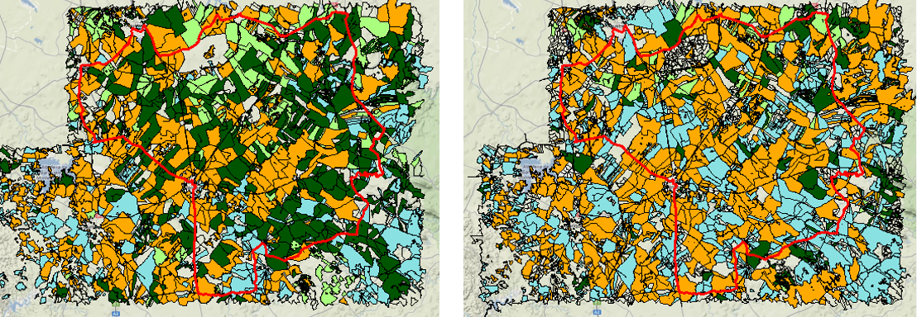

TPSD – Theories & Practices of Sustainable Development
4th lecture
19 march 2021
Analysing ecosystem management CHOICES and their IMPACTS on Biodiversity & Ecosystem Services: The Farming System Approach
José Lima Santos
Centro de Estudos Florestais (CEF),
Instituto Superior de Agronomia da Universidade de Lisboa (ISA / Ulisboa)
Email - jlsantos@isa.ulisboa.pt

Slide 2
A first idea: understanding people’s choices on land use and land cover (LULC) is key to understand major sustainability challenges
Labour productivity in agriculture (the driver)
Share of farmland in total land (the choice)
Wildfire hazard (the impact)

Slide 3
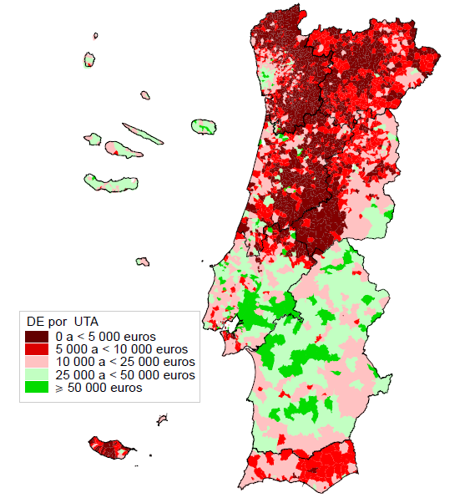
The DRIVER:
Labour productivity in agriculture (2009)

Slide 4
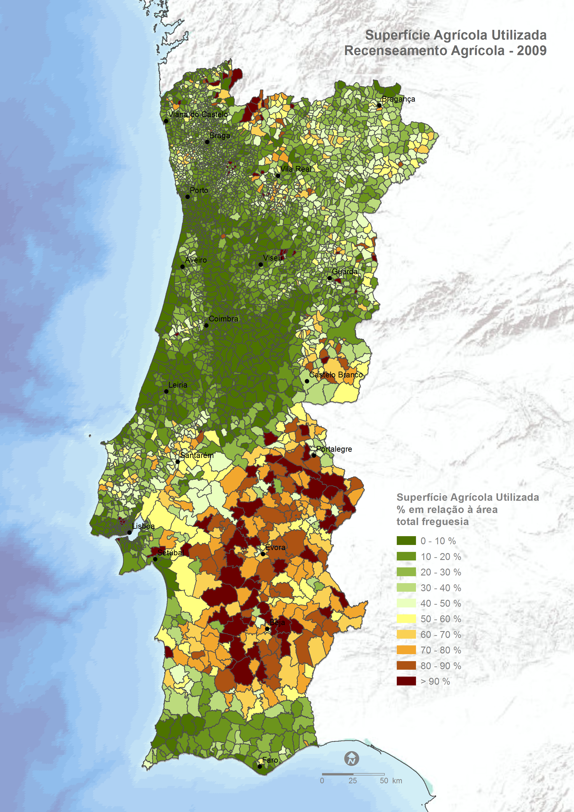
The LULC CHOICE:
Share of farmland in total land 2009 (%)

Slide 5
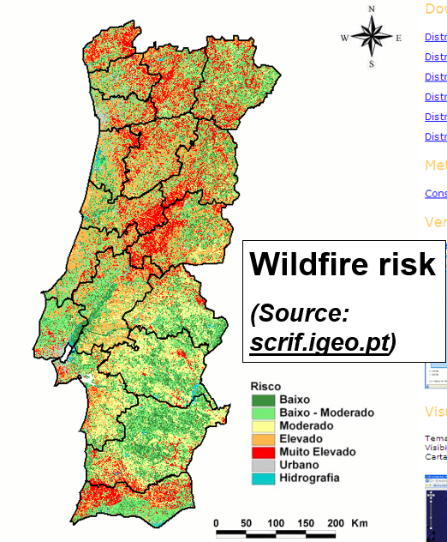
The IMPACT:
Wildfire hazard 2009

Slide 6
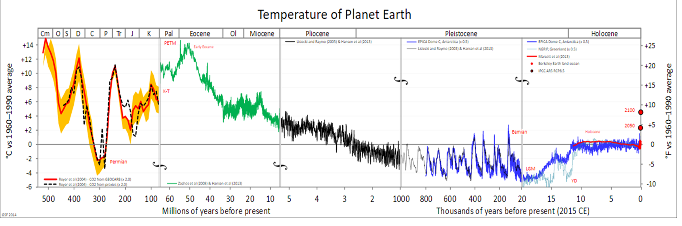
Source:
http://gergs.net/2015/06/updating-the-geological-temperature-plot/all_palaeotemps/
First, most important contributor: Burning of fossil fuels
Second: LULC change

Slide 7
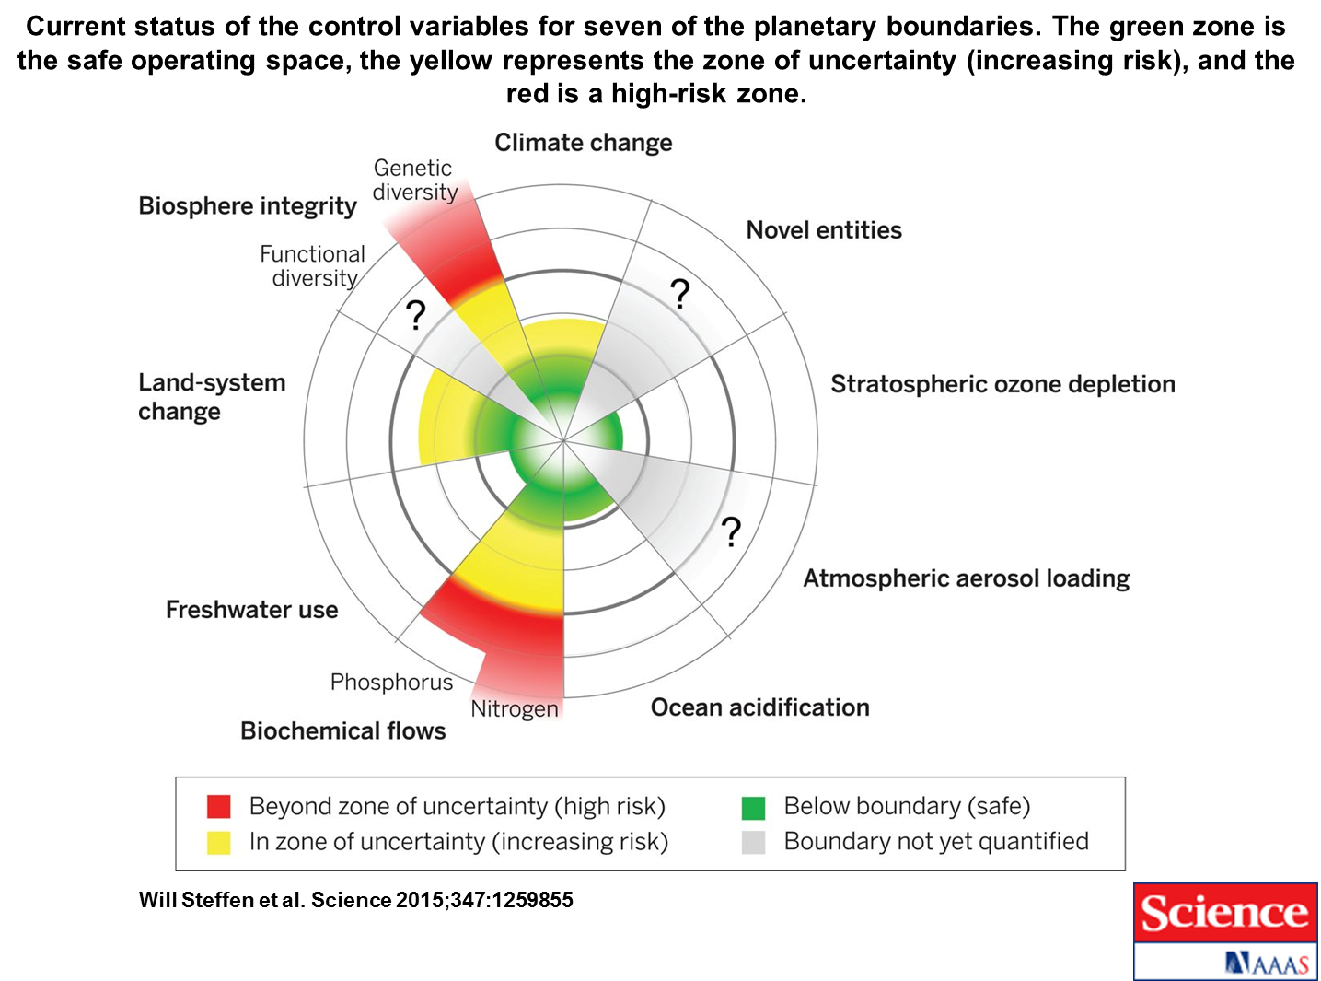

Slide 8
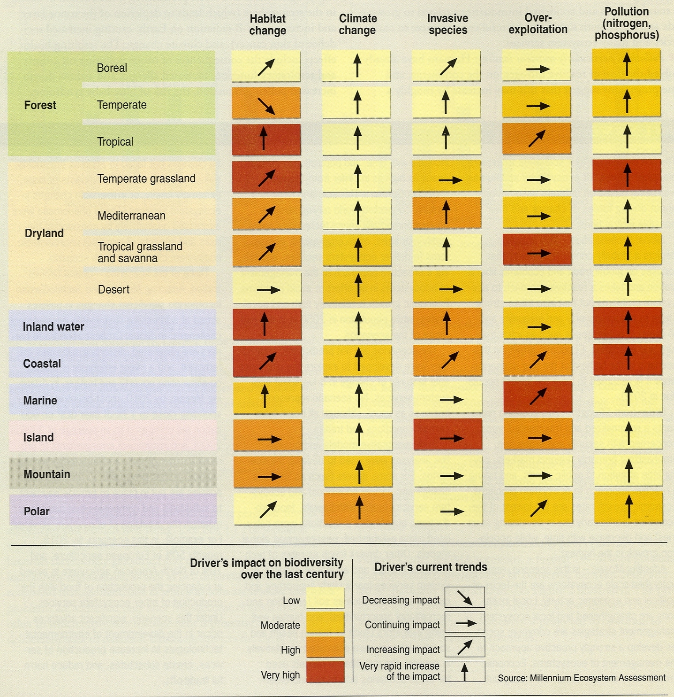

Slide 9
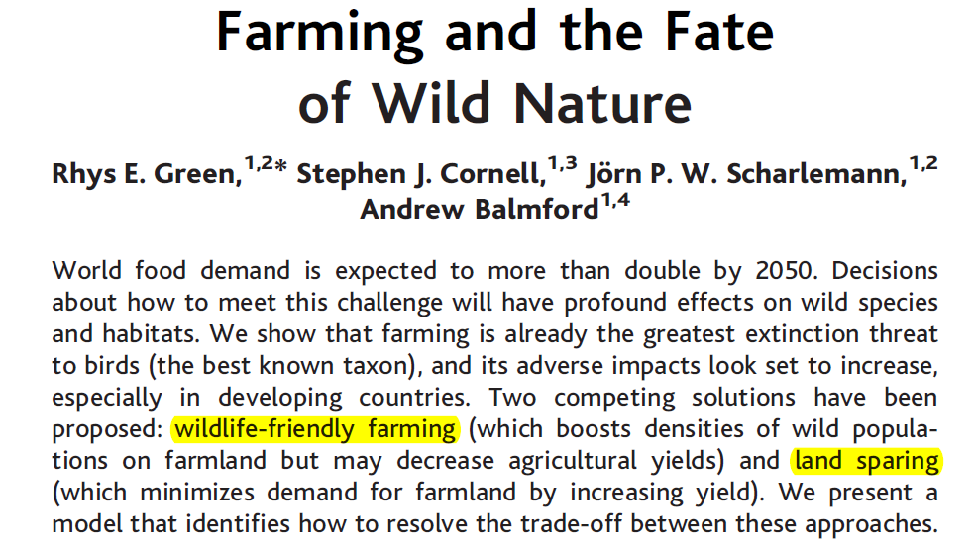

Slide 10
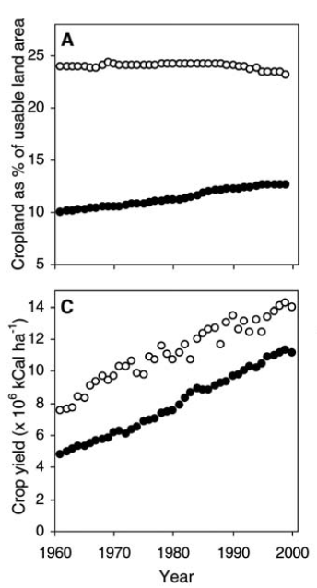
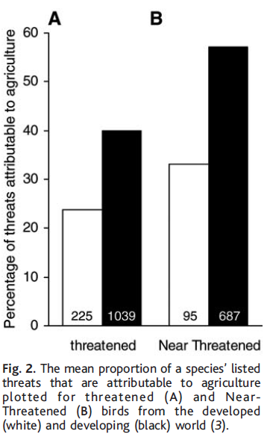
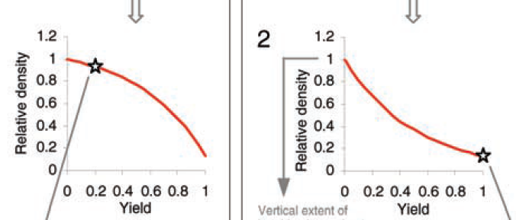

Slide 11
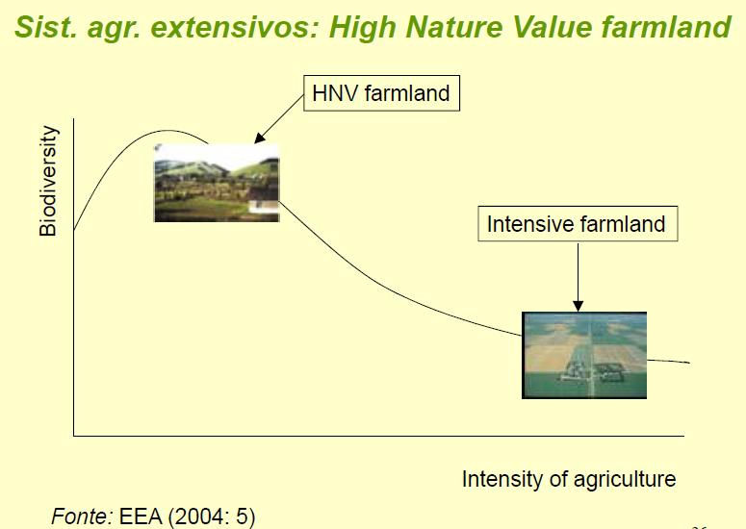

Slide 12
Not only LULC change: other aspects of land management are also key drivers of environmental change
Fertilizer use
Pesticide use
Stocking rates
Water use
… many of these are related to use intensity rather than LULC class
… and not included in most LULC analyses.

Slide 13
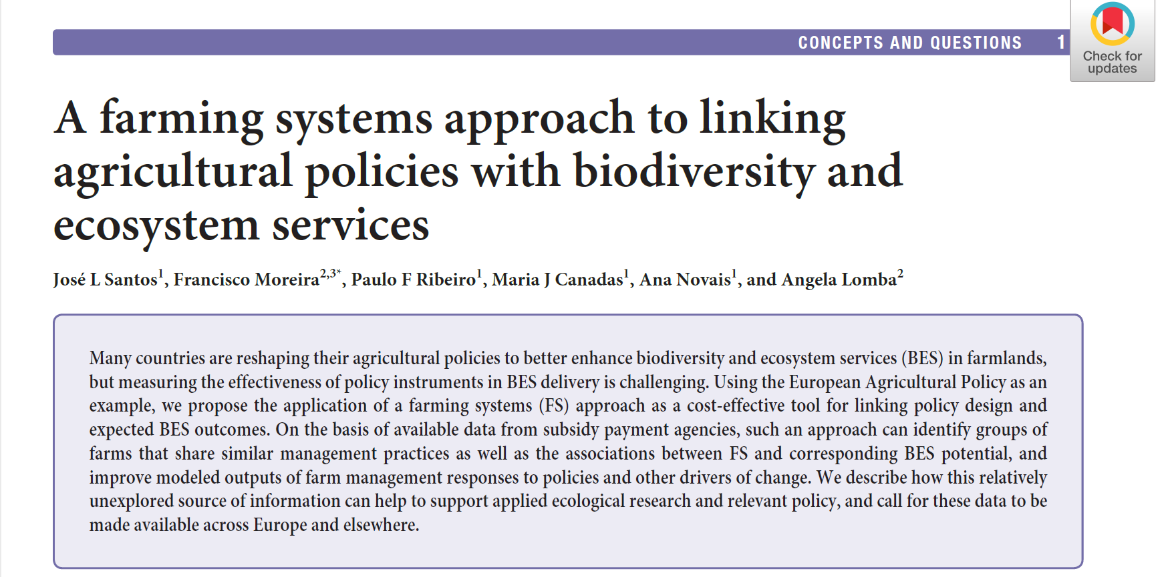

Slide 14
Farming systems – concept
Farming system analysis is a way to integrate, in a synthetic way, many aspects of land management that are relevant to understand environmental problems.
A farming system is a particular way of:
combining certain amounts of different inputs, e.g. land of a specific type, human labour, machines, fertilizers,
to produce a specific mix of outputs, e.g. milk, apples …
which is common to a set of farms.
(Claude Reboul, with adaptations)
It is the same “recipe” used by these farmers, including (1) the ingredients, (2) their relative amounts and (3) the step-by-step protocol used to combine them to get (4) the final combination of dishes.

Slide 15
Farming systems – concept
What defines a farming system is the proportions, e.g.:
% of pastures in total farmland area in the farm;
ton of maize produced per hectare;
amount of water used per hectare of irrigated land;
% of milk in the Total Revenue of the farm;
number of heads of livestock per hectare.
… not indicators of physical or economic dimension, e.g.:
total area of land in use (in hectares);
total yearly revenue (in Euros);
total livestock in the farm (in Standard Head Units).

Slide 16
Farming system – dimensions
A farming system can be described according to:
Output intensity, in ton of output per hectare or Euros of Revenue per hectare;
Input intensity, in cubic meters of water per hectare, Kg of fertilizer per hectare or overall Intermediate Consumption in Euros per hectare;
Specialization level - according to the % of the most relevant output in Total Revenue or Income, farms are either specialized or polyculture farming;
Specialization pattern, i.e. the main outputs and their proportions;
Capital to labour ratio, mechanization level or other general indicators of technology.

Slide 17
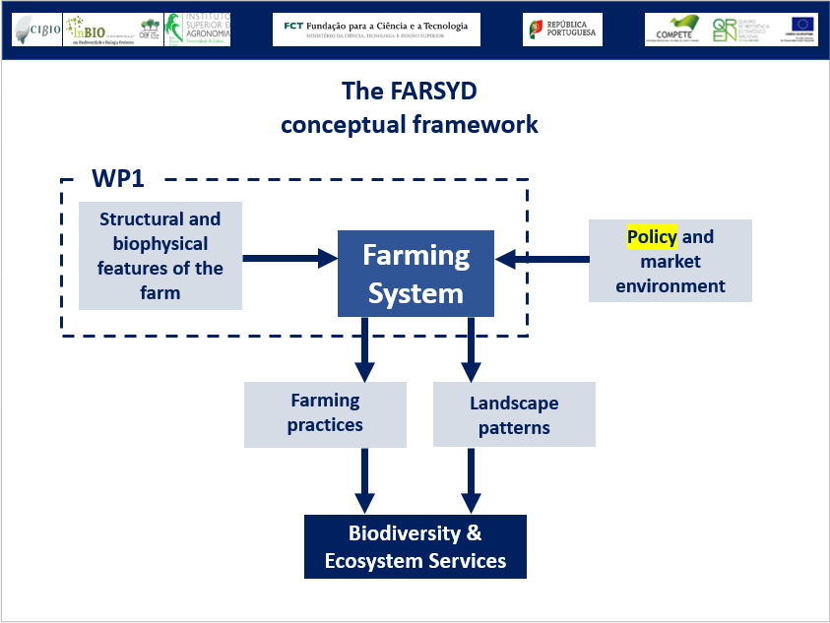
Farming system choice – drivers

Slide 18
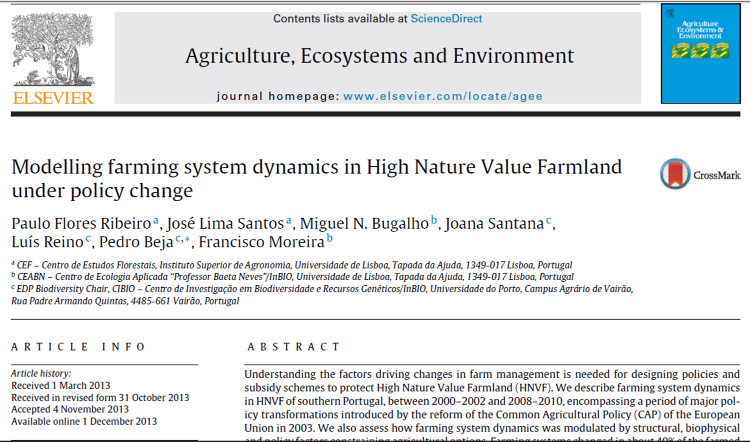
Farming systems – typology
The farming system concept has been used to classify the farms within a particular region; an example:

Slide 19
Farming systems – typology
Used variables (built based on data from IFAP/CAP paying agency)
Cereals | Proportion of dryland cereals in Utilized Agricultural Area (UAA)
Fallow land | Proportion of fallows in UAA
Pastures | Proportion of pastures and forages in UAA
Other annual crops | Proportion of other (more intensive) annual crops in UAA
Permanent crops | Proportion of permanent crops (olive groves) in UAA
Stocking rate (livestock intensity) | Number of standardized Livestock units (LU) per hectare of land with pastures and forages
% Bovines | Proportion of bovine LU in total livestock (also in LU)
Clustering method: PAM (partition around medoids – carried out in R software)

Slide 20
Farming systems – typology
The result:
 | Traditional System (polyculture, low-intensity) | Specialized Annual Crops (more intensive) | Specialized Cattle low-intensity | Specialized Sheep low-intensity | Specialized Olive groves (intensive)
Cereals | 0.28 | 0.58 | 0.14 | 0.10 | 0.00
Fallow land | 0.25 | 0.10 | 0.06 | 0.00 | 0.00
Pastures | 0.42 | 0.00 | 0.77 | 0.88 | 0.00
Other annual crops | 0.04 | 0.31 | 0.00 | 0.00 | 0.00
Permanent crops | 0.00 | 0.02 | 0.03 | 0.02 | 1.00
Stocking rate (livestock intensity) | 0.15 | 0.00 | 0.46 | 0.23 | 0.00
% Bovines | 0.00 | 0.00 | 0.85 | 0.00 | 0.00

Slide 21
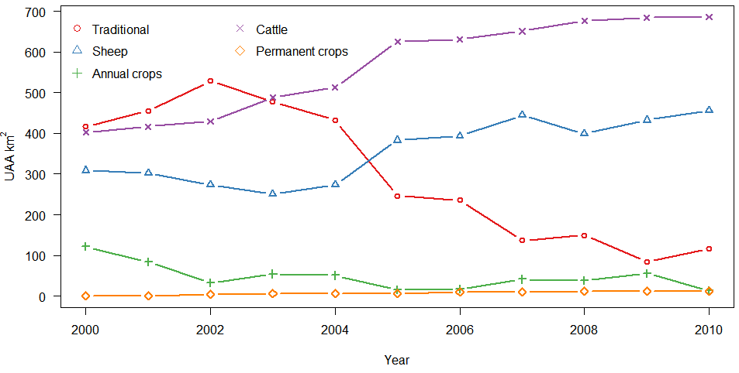
Farming system change

Slide 22
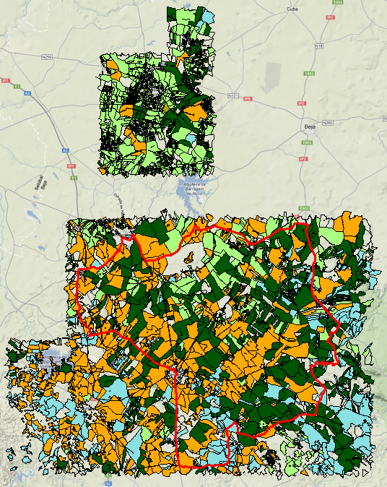
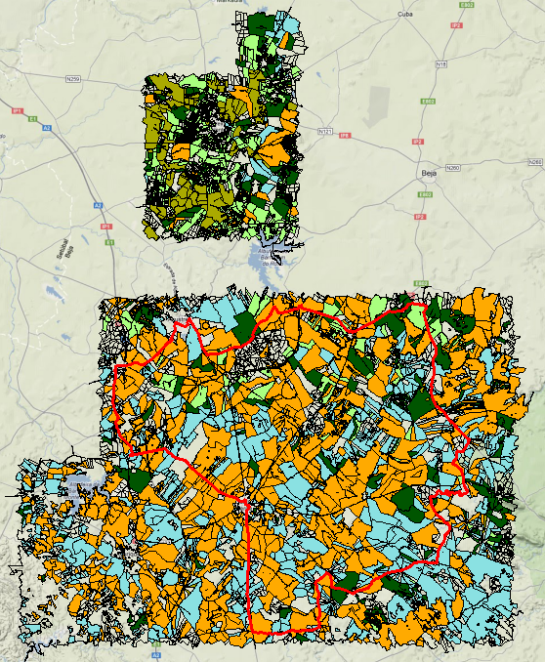
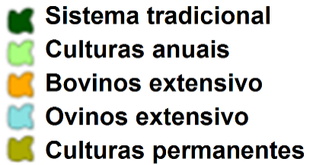
Mapping Farming system change
BEFORE CAP reform
(2000-2002)
AFTER CAP reform
(2008-2010)

Slide 23
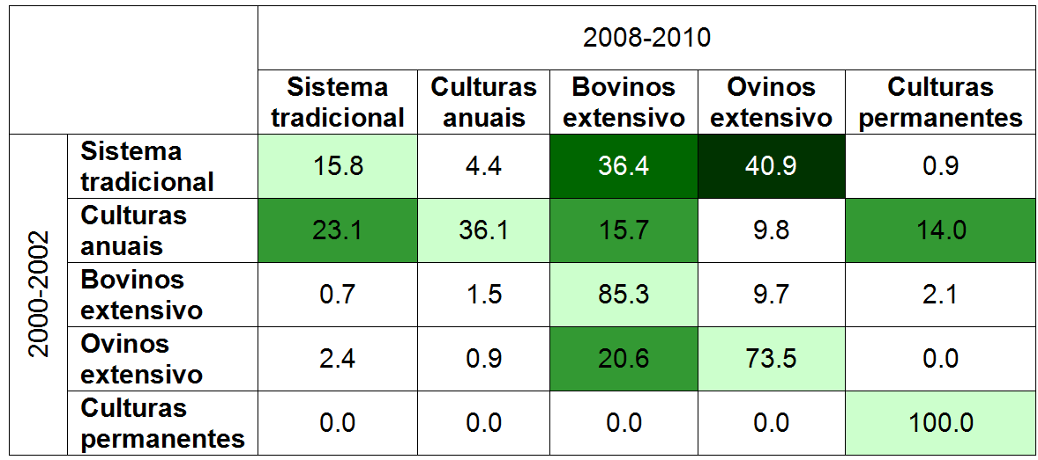
Farming system change
(Transition matrix)

Slide 24
Farming system change
- the drivers
 | Tradicional | Annual crops | Cattle | sheep | Olive groves
Traditional |  | Soil quality, Montado | Size | Soil quality, Size | -
Annual crops | Montado | Soil quality | Soil quality | Soil quality | Soil quality
Cattle | - | - |  | ZPE Size Soil quality | -

Slide 25
Farming system change
(discussion)
CAP reform and emerging market opportunities have been identified as major drivers for:
the substitution of a polycultural, low-intensity traditional farming system, which is often associated with the high biodiversity value of the region, by specialized cattle and sheep rearing systems (also low-intensity);
the substitution of a specialized, intensive annual-crops system by an also specialized, super-intensive olive-groves system.
The traditional system was not significantly affected by intensification towards intensive annual crops or intensive olive production;
It has mostly been affected by specialization towards specialized livestock systems.

Slide 26
Farming system change
(discussion)
Some specific characteristics of farms promoted particular farming system transitions:
Fertile soils tend to promote the persistence of the specialized annual crops system, the transition from traditional to annual crops and the transition from annual to permanent crops;
Poorer soils tend to promote the transition from the traditional to specialized sheep system, or the transition from annual crops to the specialized livestock systems (either cattle or sheep);
Larger farm size tends to promote the transition from the traditional to the specialized cattle system;
Small farm size tends to promote the transition from the traditional and cattle to the specialized sheep system.

Slide 27
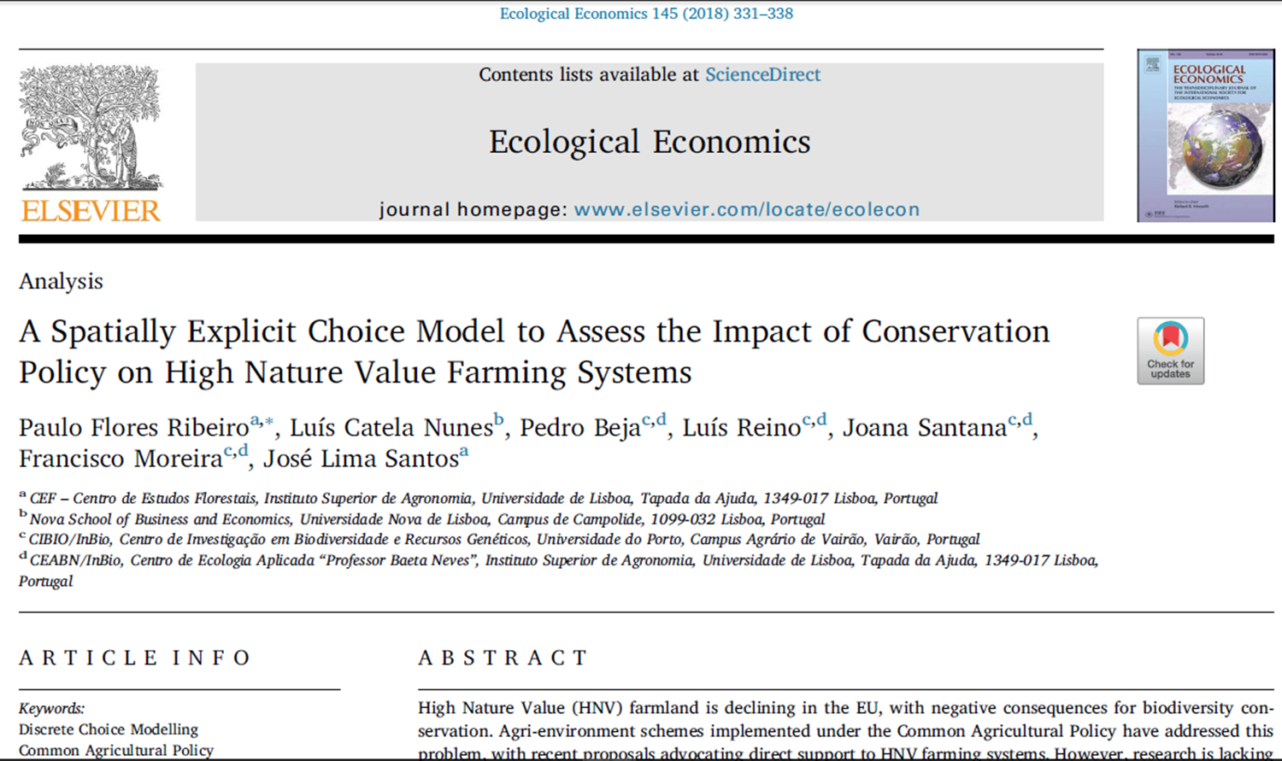
Drivers of farming system choice and policy analysis
In this study, drivers of farmers’ choice of farming system were analysed and used in policy analysis.

Slide 28
Drivers of farming system choice and policy analysis
Study’s goals:
Identify main drivers affecting the choice of farming system by the farmer;
Model the farmer’s choice of farming system;
Use the estimated choice model to assess the effect of different policy options on farmers’ choices of farming system (FS)
… and then on environmental variables depending on FS.

Slide 29
Drivers of farming system choice and policy analysis
Method:
Farms in the study area were classified by farming system in each year between 2000 and 2010;
The values of biophysical, structural, market and policy variables (drivers) were assessed for each farm in each year between 2000 and 2010;
Logistic regression was used to model the choice of farming system in each year

Slide 30
Drivers of farming system choice and policy analysis
Choice model (Logit) specification
Dependent variable (categorical):
Farming system
Independent variables (drivers):
Biophysical (soil, rain, slope)
Structural (Farm size, Oak, Janus)
Policy (SPA in/out)
Economic (GIR, GIRdif)
Inertia (FSlag)

Slide 31
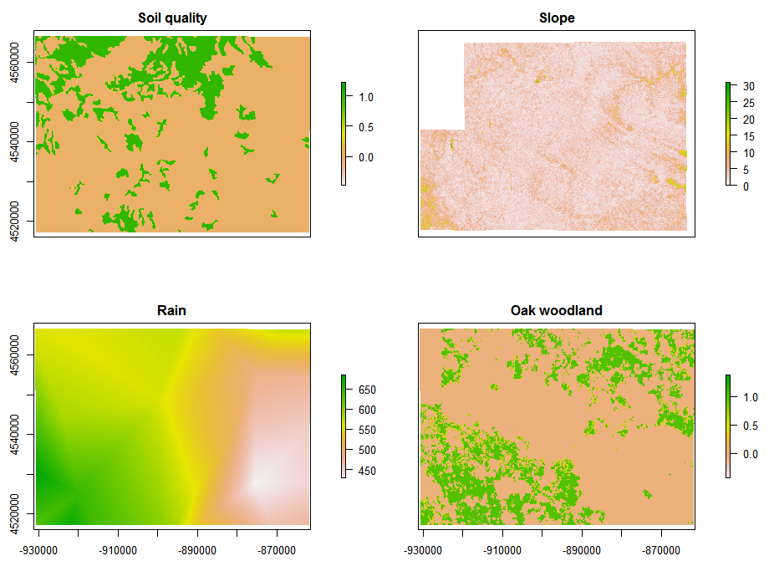
Drivers of farming system choice and policy analysis
Biophysical drivers mapping:

Slide 32
Drivers of farming system choice and policy analysis
Results: Estimated choice model (dep. variable = 1 when traditional FS chosen; else = 0)
 | Coefficient (B) | Std. error | z value | Pr(>|z|)
Intercept | -1.187 | 0.950 | -1.250 | 0.211
GIR | 6.140 | 0.703 | 8.739 | <0.001***
GIRdif | 4.093 | 1.033 | 3.962 | <0.001***
FSlag | 2.498 | 0.170 | 14.704 | <0.001***
SOIL | 1.629 | 0.294 | 5.538 | <0.001***
RAIN | -9.525 | 1.530 | -6.225 | <0.001***
UAA | -0.130 | 0.041 | -3.136 | 0.002**
JANUS | -0.884 | 0.383 | -2.305 | 0.021*
Significance codes: 0 ‘***’ 0.001 ‘**’ 0.01 ‘*’ 0.05
Model fit: Log-likelihood = -531.95 (df = 8); AIC = 1079.9; BIC = 1123.2

Slide 33
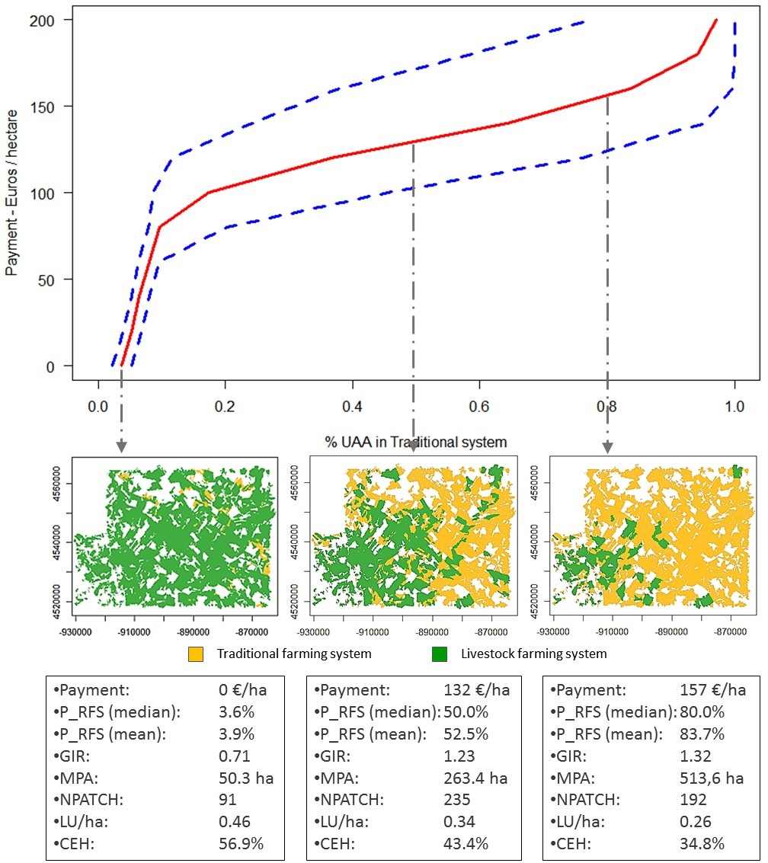
Drivers of farming system choice and policy analysis
Results: spatially-explicit supply function for biodiversity conservation (if this linked to the traditional FS)
P_RFP - % of area under the traditional FS
GIR – gross income ratio
MPA – Mean patch area
NPATCH – Number of patches
LU/ha – Livestock density
CEH – Early harvest (% of cropland harvested before the 31st May)

Slide 34
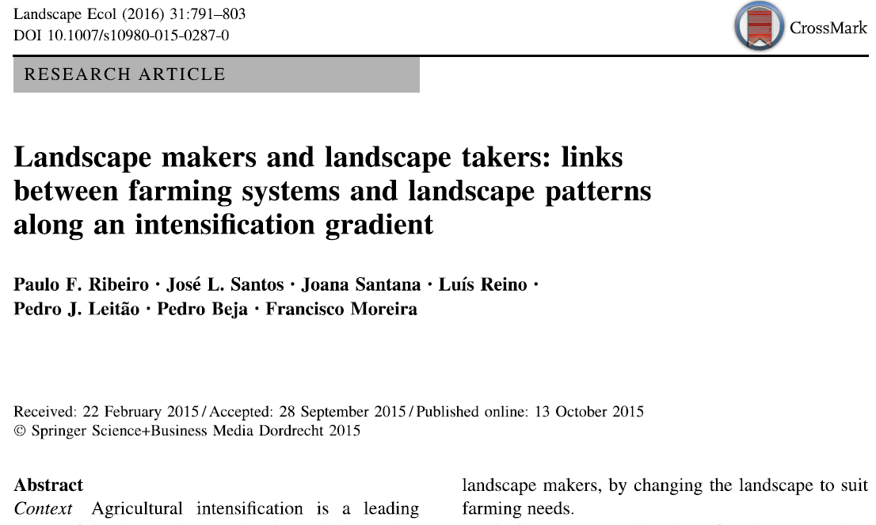
Farming systems’ effects on the landscape
In a different study, we compared landscape variables across the different farming systems in the area.

Slide 35
Farming systems’ effects on the landscape
Method:
Comparing values of several landscape metrics across different farming systems.
Sample:
Random circles with 1 sq. Km
Totally included in a single Farming system (FS)
No overlap among sampling circles
Minimum of 30 circles per FS

Slide 36
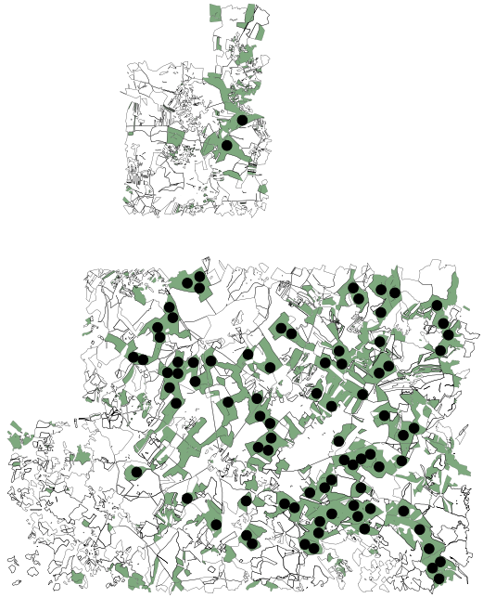
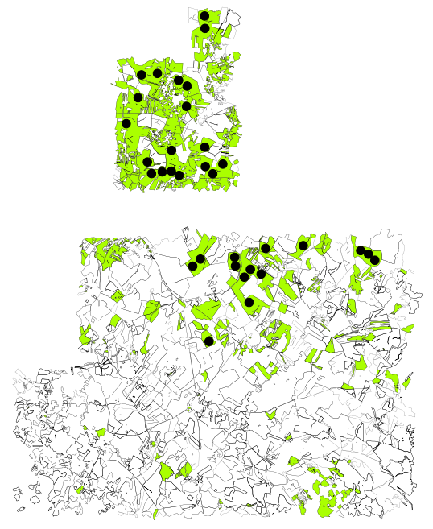
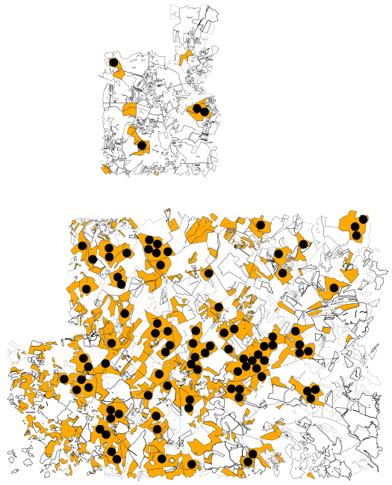
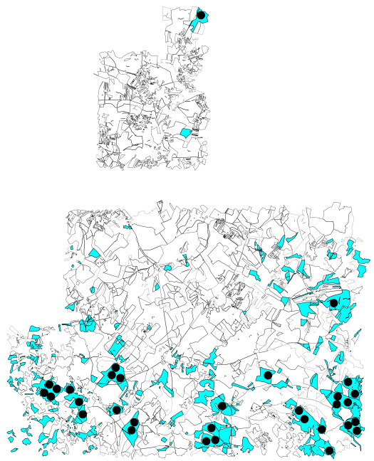
Farming systems’ effects on the landscape
Sampling landscape circles in Farming system maps
Traditional (n=85) | Annual crops (n=33) | Cattle (n=91) | Sheep (n=32)

Slide 37
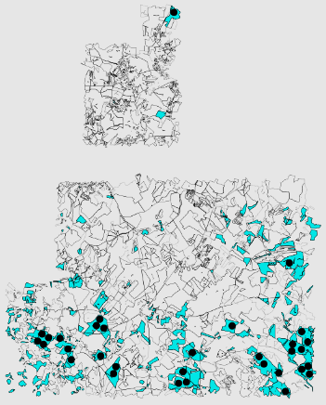
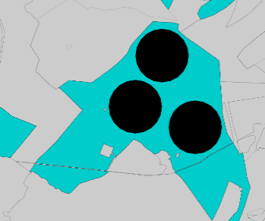
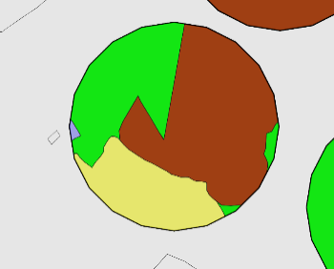
Farming systems’ effects on the landscape
Landscape metrics
VARIABLE | DESCRIPTION | Mean ± SD (Min-Max)
Landscape configuration variables:
NPATCH | Number of patches in each plot | 6.05 ± 3.36 (1 – 20)
TEDG | Total edges (plot boundary excluded) in each plot (meters) | 63.74 ± 35.01 (0-185.09)
PSCOV | Patch size coefficient of variance (patch size standard deviation divided by the mean patch size) | 111.22 ± 46.79 (0-285.92)
AWMSI | Area weighted mean shape index (area weighted sum of each patches perimeter divided by the square root of patch area for all patches and adjusted for the plot, divided by the number of patches) | 1.44 ± 0.27 (1 – 2.49)
Landscape composition variables:
NUSES | Number of different land uses/covers (LUC) in each plot | 3.90 ± 1.29 (1 – 8)
SDI | Shannon diversity index on LUC in each plot | 0.87 ± 0.35 (0 – 1.73)
CEREAL | proportion of cereal crops in each plot | 0.27 ± 0.23 (0 - 0.99)
FALLOW | proportion of fallows in each plot | 0.16 ± 0.19 (0 - 0.91)
BSOIL | proportion of bare soil in each plot | 0.01 ± 0.06 (0 - 0.75)
PASTURE | proportion of permanent pastures in each plot | 0.38 ± 0.31 (0 - 1.00)
SHRUB | proportion of shrublands in each plot | 0.02 ± 0.06 (0 - 0.40)
LEGUM | proportion of leguminous crops in each plot | 0.01 ± 0.05 (0 - 0.37)
FORAGE | proportion of forage crops and temporary pastures in each plot | 0.01 ± 0.04 (0 - 0.34)
FOREST | proportion of forest in each plot | 0.05 ± 0.14 (0 - 0.89)
PERMCROP | proportion of permanent crops (olive groves) in each plot | 0.01 ± 0.04 (0 - 0.42)
OTHACROP | proportion of other annual crops in each plot | 0.06 ± 0.15 (0 - 0.90)
SOCIAL | proportion of social areas (roads, buildings) in each plot | 0.00 ± 0.01 (0 - 0.13)
WETLAND | proportion of wetland areas (rivers, dams, reservoirs) in each plot | 0.01 ± 0.03 (0 - 0.34)
MONTADO | proportion of “montado” in each plot | 0.22 ± 0.32 (0 – 0.98)

Slide 38
Farming systems’ effects on the landscape
Principal Component Analysis
(using varimax of the 7 PC with eigenv. > 1)
Variable loadings
 | PC1 | PC2 | PC3 | PC6 | PC4 | PC7 | PC5
 | (Heter.) | (Special.) | (P. crops) | (Forage) | (Social) | (Fallows) | (Legum.)
Explained var. (%) | 0.24 | 0.11 | 0.08 | 0.07 | 0.07 | 0.06 | 0.06
Cumulative var. (%) | 0.24 | 0.35 | 0.43 | 0.50 | 0.56 | 0.63 | 0.69
NPATCH | 0.91 | 0.02 | 0.07 | 0.09 | -0.01 | -0.04 | 0.01
TEDG | 0.91 | 0.23 | 0.07 | 0.02 | -0.05 | -0.11 | 0.01
NUSES | 0.78 | 0.08 | 0.27 | 0.31 | 0.15 | -0.01 | 0.06
AWMSI | 0.75 | 0.01 | 0.01 | -0.35 | 0.00 | -0.02 | 0.05
SDI | 0.73 | 0.31 | 0.20 | 0.13 | -0.04 | -0.25 | 0.04
PSCOV | 0.72 | 0.04 | -0.04 | 0.13 | -0.03 | 0.12 | -0.03
PASTURE | -0.28 | -0.79 | -0.27 | 0.01 | 0.22 | 0.10 | 0.19
CEREAL | 0.08 | 0.78 | -0.16 | -0.01 | -0.01 | 0.07 | 0.27
OTHACROP | 0.06 | 0.53 | 0.13 | -0.03 | 0.15 | 0.00 | -0.11
PERMCROP | 0.06 | 0.09 | 0.77 | -0.18 | 0.22 | -0.01 | 0.11
WETLAND | 0.12 | 0.08 | 0.72 | 0.10 | -0.02 | 0.05 | 0.05
FORAGE | 0.26 | -0.11 | -0.07 | 0.72 | 0.05 | 0.00 | 0.05
SHRUB | 0.53 | -0.37 | -0.11 | -0.55 | -0.08 | 0.11 | -0.03
SOCIAL | 0.18 | 0.10 | 0.17 | 0.19 | 0.75 | 0.14 | -0.05
MONTADO | -0.30 | -0.18 | 0.06 | -0.07 | 0.54 | -0.17 | -0.25
FOREST | 0.08 | -0.28 | 0.39 | 0.34 | -0.46 | 0.11 | -0.39
FALLOW | 0.23 | 0.23 | -0.05 | -0.06 | -0.12 | -0.71 | -0.34
BSOIL | 0.05 | 0.15 | 0.03 | -0.07 | -0.07 | 0.71 | -0.28
LEGUM | 0.08 | -0.04 | 0.17 | 0.05 | -0.14 | -0.05 | 0.78

Slide 39
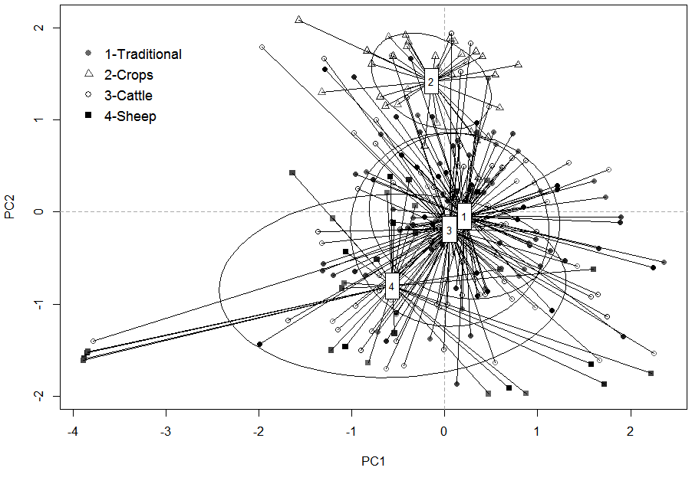
Farming systems’ effects on the landscape
Scatterplot of the 241 observations on the 2 first PCs

Slide 40
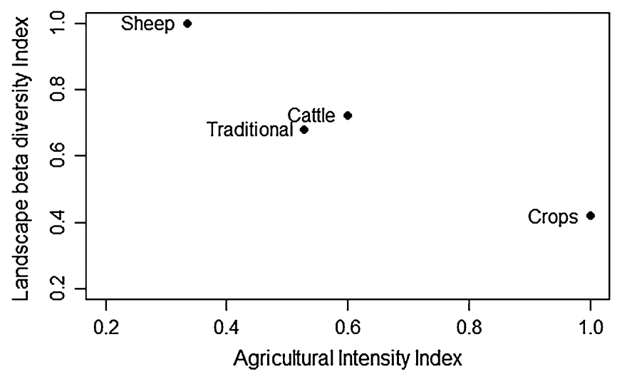
Farming systems’ effects on the landscape
Relationship between “landscape flexibility” and the intensity level of the Farming system
Landscape Flexibility Index - Average Euclidean distance to group centroids (standardized by the highest value)
Agricultural Intensity Index – Weighted average of unitary gross margins of the different crops and activities in each farming system (standardized by the highest value)

Slide 41
Farming systems’ effects on the landscape
Synthesizing…
High intensity
< Landscape flexib.
➔ “LANDSCAPE MAKERS”
Farming system
Low intensity
> Landscape flexib.
➔ “LANDSCAPE TAKERS”

Slide 42
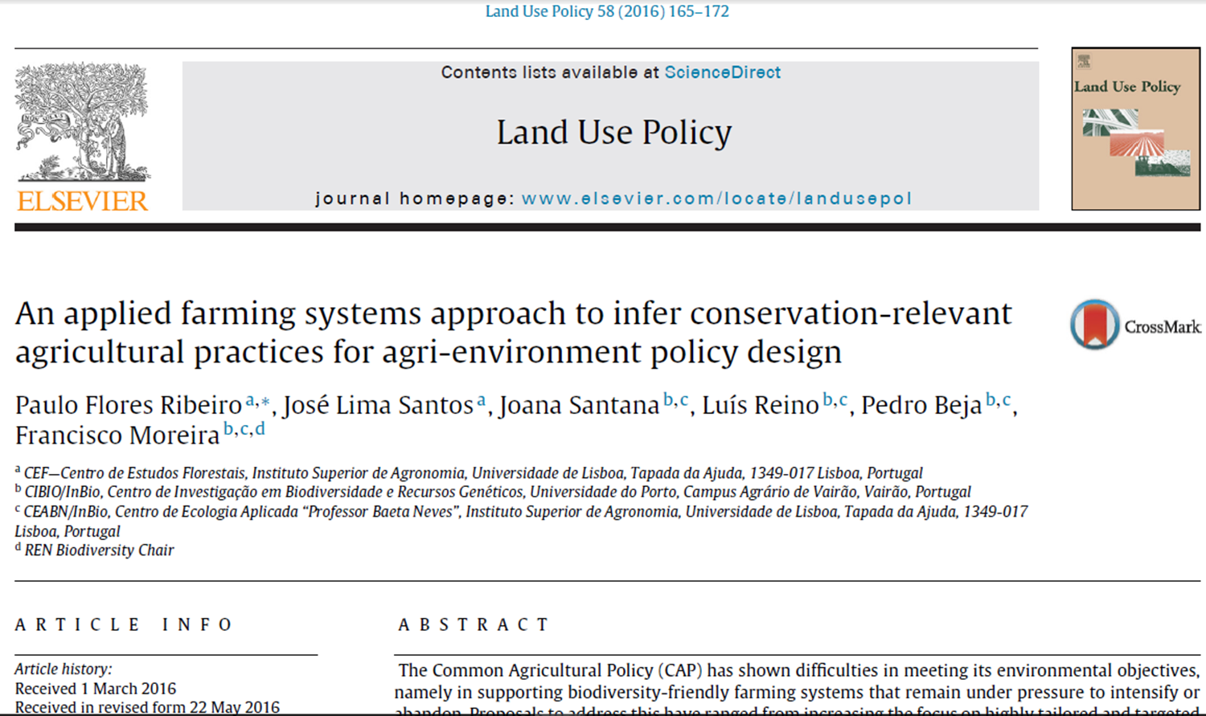
Farming systems’ effects on biodiversity conservation
In another study, we compared the different farming systems from a biodiversity conservation perspective.

Slide 43
Farming systems’ effects on biodiversity conservation
Methodological approach:
Conservation-relevant farming practices were first identified based on a literature review;
200 farms in the study area were then surveyed and asked about conservation-relevant farming practices
Sampled farms were classified into farming systems using cluster analysis
Differences in conservation-relevant farming practices were eventually analysed across farming systems.

Slide 44
Farming systems’ effects on biodiversity conservation
Variable | Code | Description | Mean ± SD (Min-Max)
Farm characterization variables:
Dry cereals | CEREAL | % UAA with dry cereals | 19.9 ± 16.9 (0-100)
Other annual crops | OTHCROP | % UAA with other annual crops | 1.0 ± 4.4 (0-55.6)
Permanent crops | PCROP | %UAA with permanent crops | 0.8 ± 3.0 (0-20.0)
Fallows | FALLOW | % UAA with fallows | 64.4 ± 26.1 (0-100)
Pastures | PPAST | % UAA with pastures | 13.9 ± 25.1 (0-100)
Cattle ratio | CRATIO | % of cattle LU in total LU | 31.5 ± 43.1 (0-100)
Livestock density | STOCKDENS | LU per hectare of fodder area | 0.37 ± 0.44 (0-2)
Farming practices variables:
Fertilizers | FERTILIZERS | % UAA fertilized | 21.4 ± 17.7 (0-100)
Herbicides | HERBICIDES | % UAA treated with herbicides | 6.6 ± 13.9 (0-82.6)
Direct drill | DIRCTDRILL | % UAA under direct drill | 0.6 ± 5.6 (0-70.8)
Plough | PLOUGH | % UAA ploughed or disked | 18.9 ± 18.4 (0-100)
Mechanical operations | N_MECOP | Number of mechanical operations in arable land (typical year) | 3.48 ± 1.31 (0-7)
Irrigation | IRRIGAT | % UAA irrigated | 1.1 ± 8.4 (0-100)
Stubs not grazed | STUBNGRAZ | % UAA with ungrazed stubbles | 3.2 ± 12.4 (0-100)
Improved pastures | PASTPLUS | % UAA with improved pastures | 6.4 ± 17.0 (0-100)
Wildlife plots | WLIFEPLOT | % UAA with wildlife food plots | 0.8 ± 2.1 (0-17.8)
Conservation buffers | CONSBUFF | % UAA with conservation buffers | 7.1 ± 14.6 (0-100)
Stockpiled forages | STOCKFOR | % UAA with stockpiled forages | 8.7 ± 13.1 (0-69.6)
Crop rotation | ROTYEARS | Duration of crop rotation (years) | 1.82 ± 2.09 (0-5.00)
Early harvest | EARLYHARV | % of the cereal area that is harvested before 31th May | 42.0 ± 49.1 (0-100)
Wire fences | WIREFENCE | Meters of wire fences per hectare | 31.3 ± 71.6 (0-593.1)

Slide 45
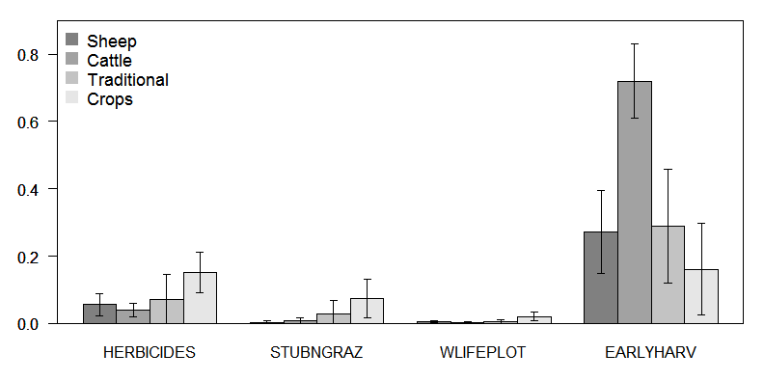
Farming systems’ effects on biodiversity conservation
45

Slide 46
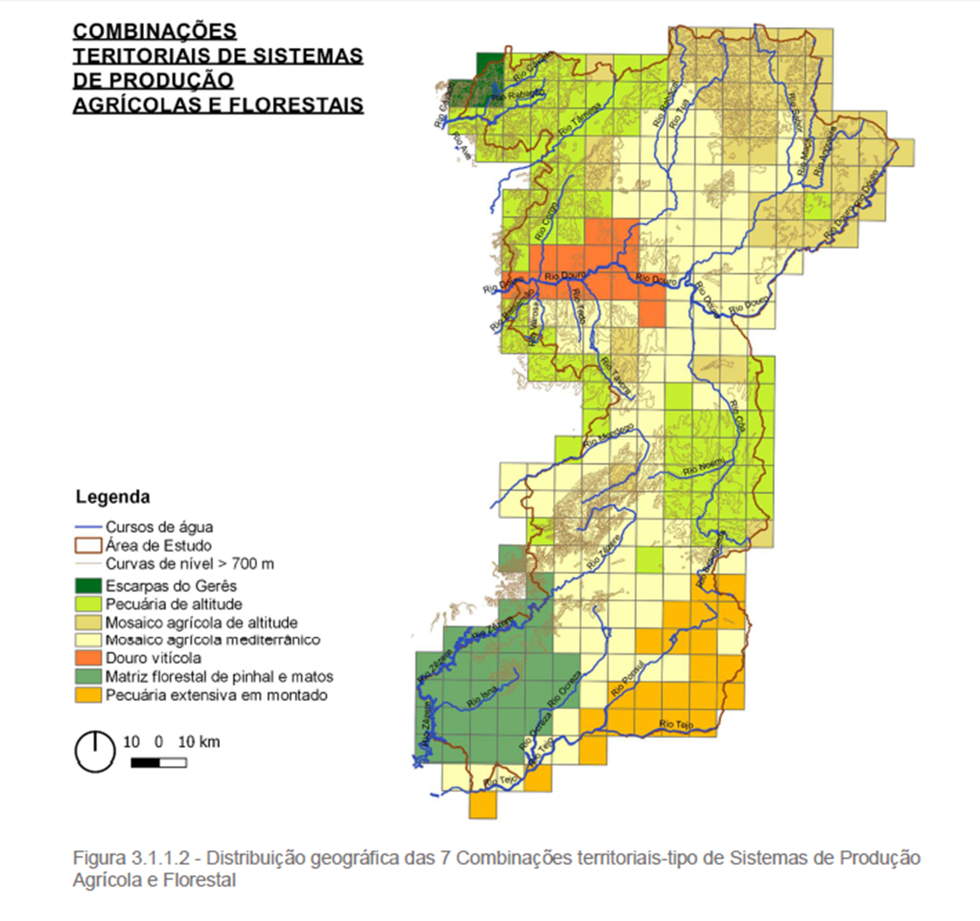
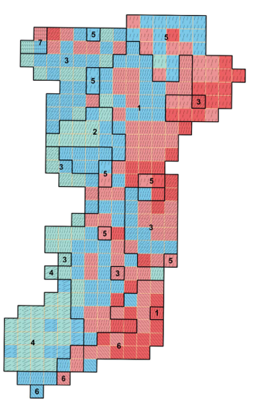
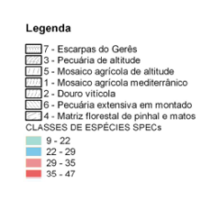
Farming systems’ effects on biodiversity conservation
In another study, we more directly compared levels of biodiversity across farming systems.

Slide 47
Brief summary of study carried out at the EU level
Feasibility study on the economic valuation of Public Goods and Externalities (PGaE) of EU
Building an empirically-based framework to value PGaE of agriculture at broad supranational scales

Slide 48
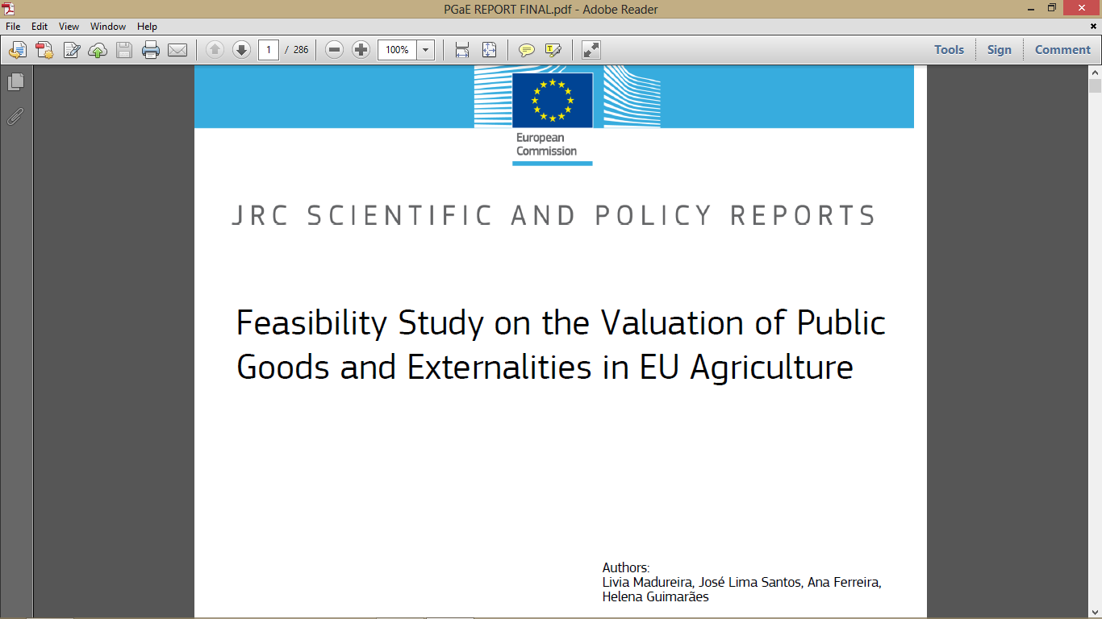

Slide 49
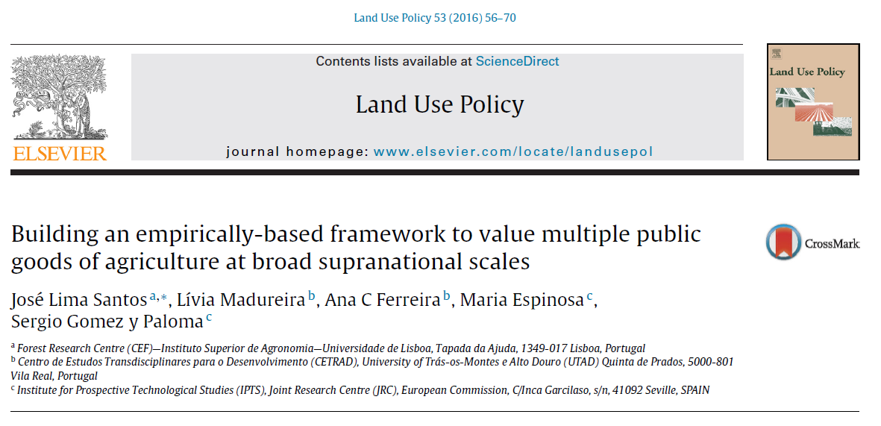

Slide 50
Challenges in developing a framework to value changes in multiple Ecosystem Services (PGaE of agriculture) at a macro-regional scale
To address this policy demand, the required valuation framework needs to:
  focus on available policy options at this broad, supranational scale (to be empirically robust from a supply-side perspective);
  be understandable by the general public of many involved countries (demand-side requirement);
  provide context-rich valuation scenarios, leading people to engage in actual economic trade-offs as opposed to symbolic reactions (demand-side requirement).

Slide 51
Macro-Regional Agri-Environmental Problems (MRAEP) –the core concept
A MRAEP involves four dimensions:
the particular farming systems and agricultural landscape(s) prevailing in a specific macro-region (MR);
the bundle of PGaEs currently delivered by that agro-ecological infrastructure;
an expected direction of future change in land use, e.g. farmland abandonment or agricultural intensification; and
the expected effects of such change on the delivery of PGaE in that MR.

Slide 52
A typology of MRAEPs
Building a typology of MRAEPs requires four sequential steps:
identifying and describing the MRs;
identifying the current PGaE bundle in each MR
identifying the core land-use dynamic trend in each MR
selecting the core PGaE to be valued in each MRAEP

Slide 53
Identifying Macro-Regions (MR)
Landscape variables:
Land Cover (agriculture, forest, natural and artificial classes);
Agricultural Land Use (arable, permanent crop and grassland in UAA);
Core versus Marginal Areas – percentage of UAA in different LFA classes;
Biogeographic regions; *
Farming-system variables:
Specialization Pattern – distribution of farms;
Economic Intensity of Farming - average Gross Margin per hectare;
Relevance of Irrigation - percentage of irrigated area in the UAA; *
Stocking Rates –Livestock Standard Units per hectare of UAA.
Average (physical) Farm Size in hectares; *
Distribution of Farms per Size Class;
Average Economic Farm Size, in ESU.*

Slide 54
Identifying Macro-Regions (MR)
Factor analysis run on EU-wide data including these variables at the NUT3-level
(aims: dimension reduction and avoid overweighting dimensions with more variables)
Hierarchical cluster analysis run on the first 9 factors from the PCA (eigenvalue criterion).
Resulting 13 clusters (MR) profiled using centroids and mapped using the ArcGis.

Slide 55
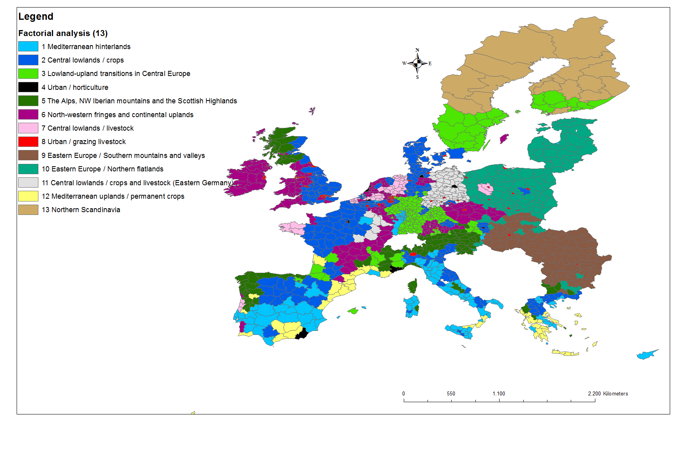

Slide 57
Used PGaE indicators:
Landscape (cultural services)
Recreation potential index (Maes et al. 2011);
Cultural heritage (Paracchini, Unpublished);
Biodiversity
High Nature Value Farmland (HNVF) – (Paracchini et al. 2008);
Water quality and availability
Infiltration (mm) – (Maes et al., 2011);
Irrigated UAA – in percentage of UAA (EC, 2011);
Total nitrogen input – (Liep et al., 2011);
Soil quality
Soil erosion – PESERA model (EC, 2011).
Soil carbon content. – Low values indicate soil quality problems; (Maes et al., 2011);
Air quality
Total NH3 emissions; (Liep et al., 2011);

Slide 58
Used PGaE indicators (Cont.):
Climate stability
Soil carbon content – High values indicate contribution to carbon storage; (Maes et al., (2011);
Total N2O emissions (Liep et al., 2011).
Resilience to flooding
Flooding risk (model LISFLOOD; Wimmer (CESR/ UK).
Resilience to fire
Fire risk – average yearly burnt (JRC).

Slide 59
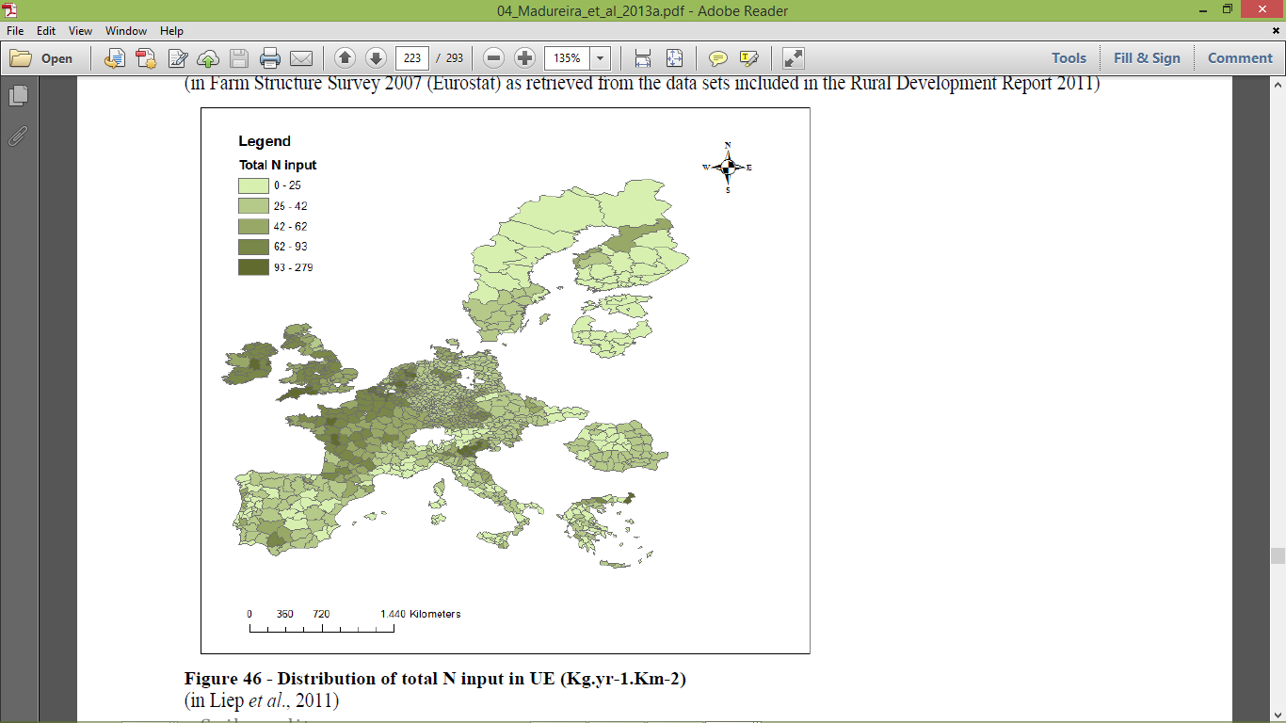

Slide 60
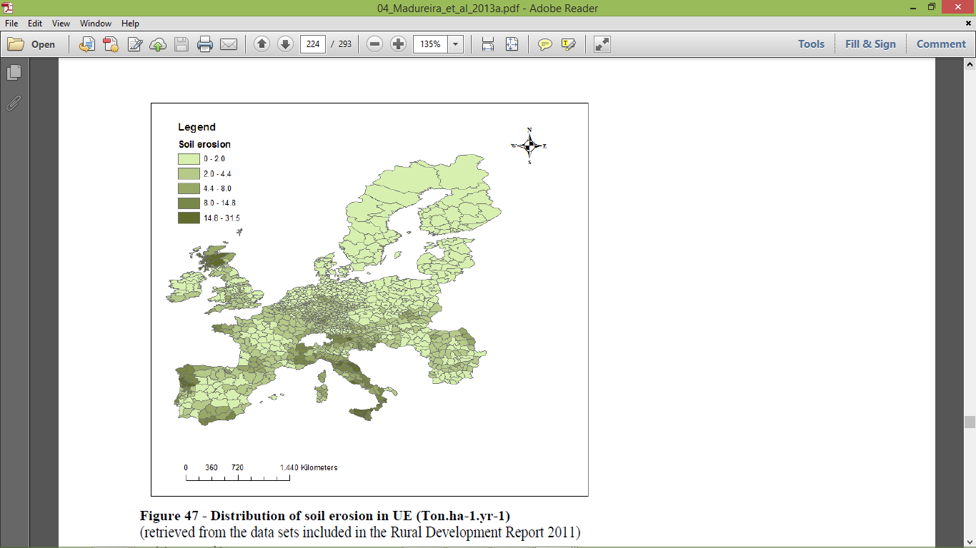

Slide 61
Profiling MR according to their typical PGaE bundle
MR examples:
The Alps, NW Iberian mountains and the Scottish Highlands;
Central lowlands/livestock
Mediterranean hinterlands and uplands
Central lowlands/crops

Slide 62
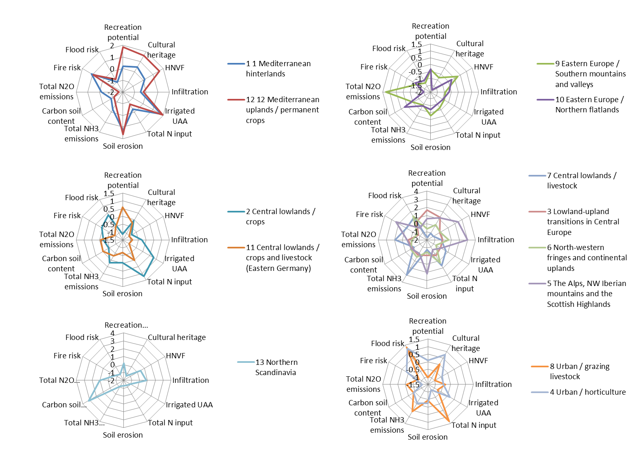

Slide 63
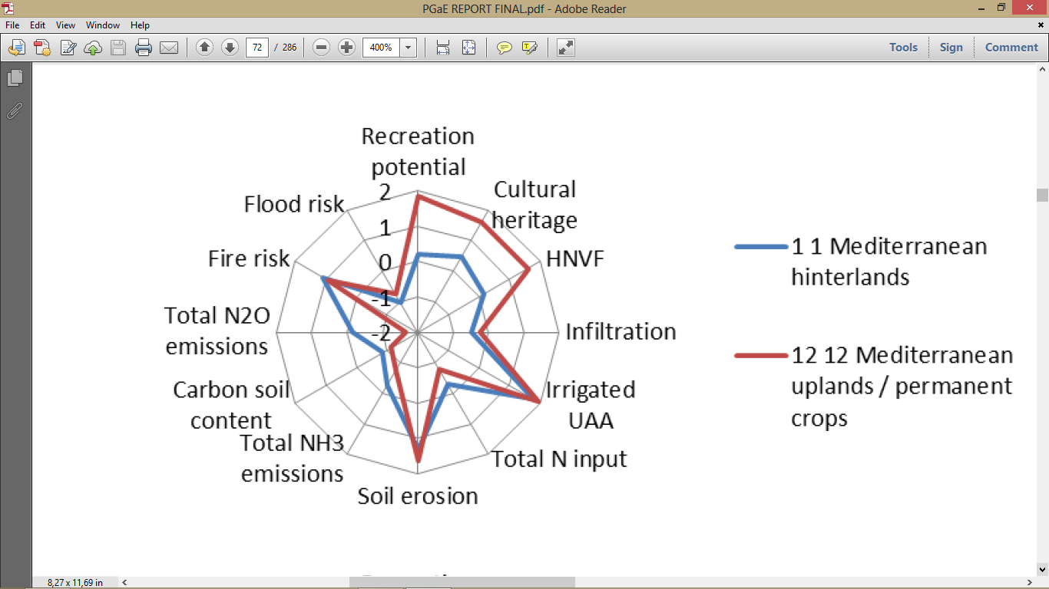

Slide 64
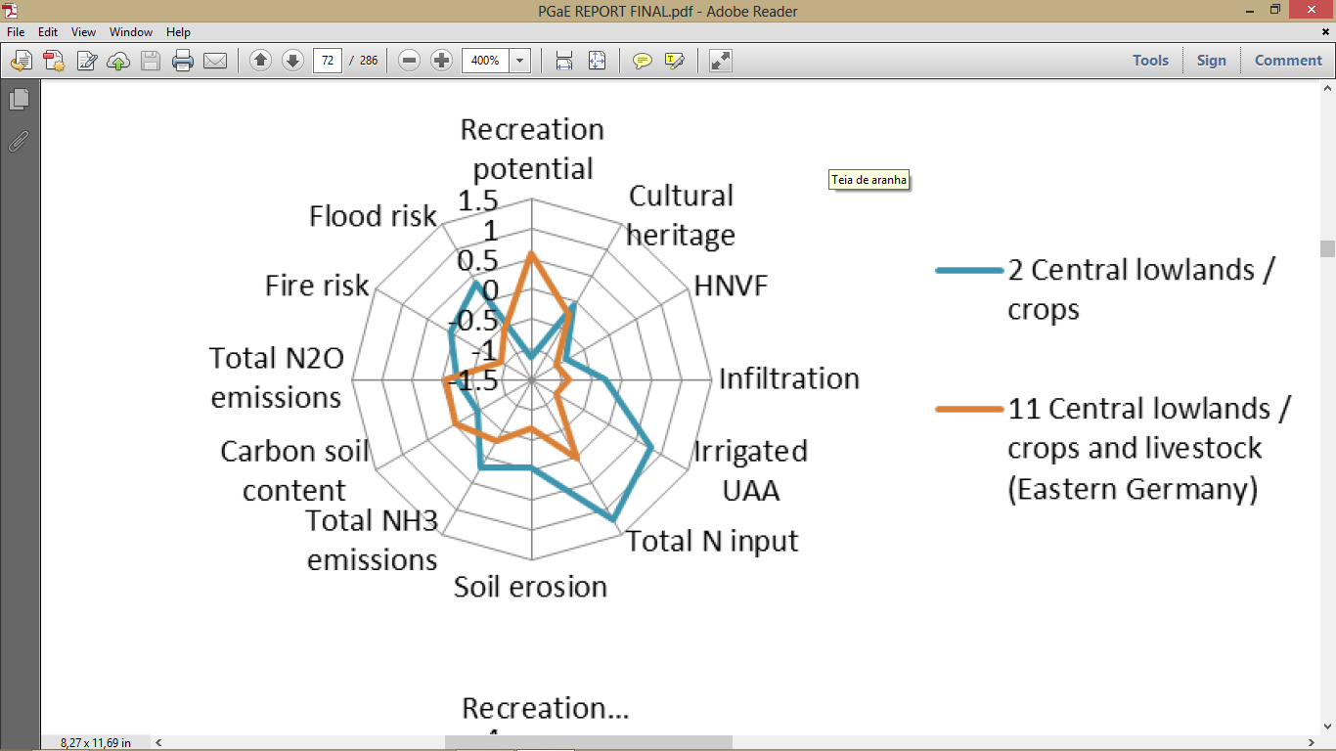

Slide 65
Selecting core PGaE to be valued in each MRAEP
When the current value of the PGaE indicator presents a level from medium-high to very high, or low to very-low, it was considered for selection when:
the dynamic trend is expected to significantly worsen the condition of the PGaE, and there is a policy option able to counteract this worsening;
the current status is negative, the dynamic trend is expected not to improve it, and there is a policy option able to improve that negative current status.

Slide 66
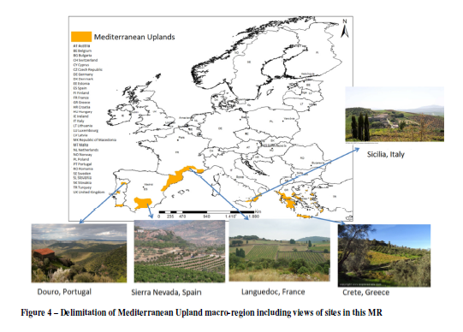
Macro-region selected for pilot survey
Survey design for the MRAEP “farmland abandonment in Mediterranean Upland”

Slide 67
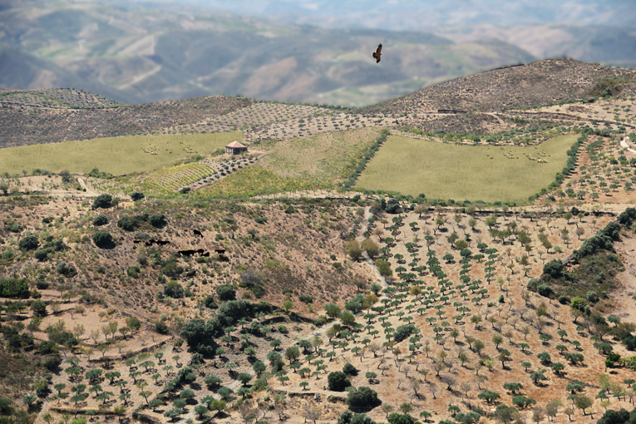
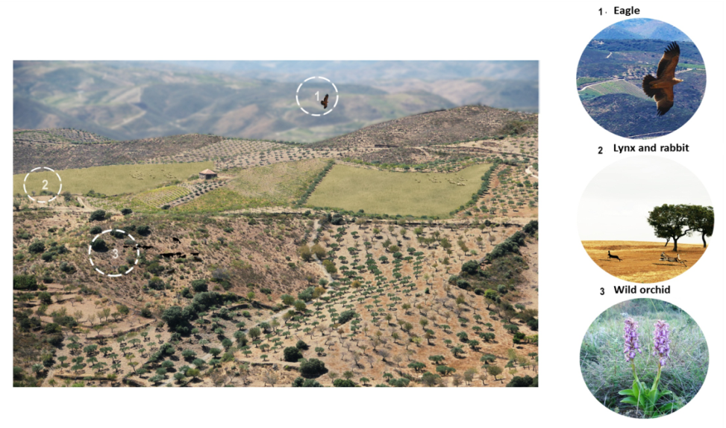
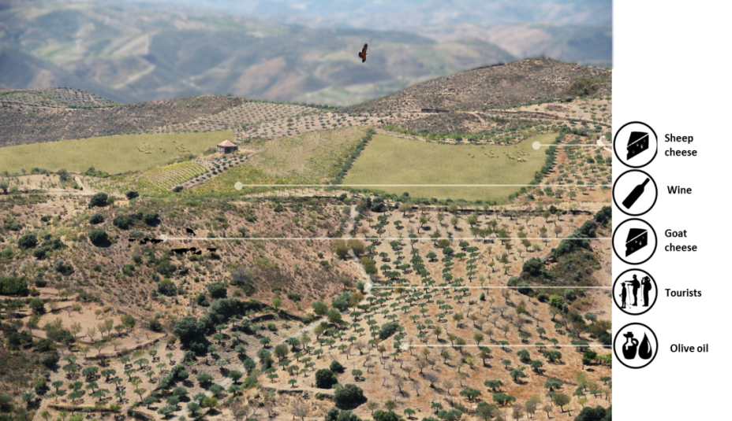
Design of Choice Modelling survey
Non-monetary attributes: selection and description –
“farmland in Mediterranean Upland and its benefits to the common-citizen”

Slide 68

Design of Choice Modelling survey
Non-monetary attributes: selection and description –
“farmland abandonment in Mediterranean Upland and its losses to the common-citizen”

Slide 69

Design of Choice Modelling survey
Non-monetary attributes: selection and description – PG programmes

Slide 70

Design of Choice Modelling survey
Choice set: number of alternatives (baseline and reference levels) –
MRAEP “farmland abandonment in Mediterranean Upland”
Example of choice set

Slide 71
Implementation of the Pilot survey
Test at pilot level of the questionnaire for–Samples
MRAEP “farmland abandonment in Mediterranean Upland”
Three samples for 300 valid interviews each have been selected
Face-to-face interviews with CAPI (computer assisted personal interviews), carry out in the Metropolitan area of Lisbon (PT)
Panel web-base (one-line) administrated for national population of Portugal
Panel web-base (one-line) administrated for national population of Germany
Criteria for sampling selection:
1. Stratified samples have been selected
Age, gender
& c) Age, Gender, NUTS2
2. Individual with 18 years old in charge of household expenses

Slide 72
Multi-country preferences for the PG
Estimates for the attributes WTP (based on estimates for MNL and RPL specifications), values are in €
PGaE | PT_F2F |  | PT_WEB |  | DE_WEB
 | MNL | RPL | MNL | RPL | MNL | RPL
Landscape | 23 | 29 | 29 | 36 | 27 | 37
IC-upper bond | 29 | 38 | 38 | 49 | 36 | 50
IC-lower bound | 16 | 21 | 21 | 23 | 19 | 23
Farmland Biodiversity | 26 | 29 | 47 | 54 | 45 | 59
IC-upper bond | 32 | 38 | 58 | 69 | 56 | 78
IC-lower bound | 19 | 19 | 36 | 38 | 34 | 40
Erosion control | 25 | 28 | 23 | 23 | 17 | 19
IC-upper bond | 32 | 38 | 31 | 33 | 24 | 30
IC-lower bound | 18 | 19 | 16 | 13 | 10 | 9
Fire risk reduction | 42 | 51 | 36 | 51 | 20 | 23
IC-upper bond | 50 | 62 | 45 | 65 | 28 | 35
IC-lower bound | 33 | 39 | 27 | 36 | 13 | 13
Note: Confidence Intervals (95% confidence level)

Slide 73
Assessing the proposed valuation framework
The design of context-rich valuation scenarios is always a challenging aspect of the design and implementation of stated-preference valuation methods,
it is even more challenging when we move to a supra-national scale.
A multi-country valuation framework for multiple PGaE for entire cross-country MRs, such as the ones discussed in this paper has never been built before, as far as we know.

Slide 74
Assessing the proposed valuation framework
Potential usefulness of the proposed framework: deliver information on the value for ordinary people of changes in multiple PGaE of agriculture at broad cross-country scales.
Useful for the evaluation of the implications of CAP reforms.
Or for a better integration of (environmental or social) non-trade issues into a full cost-benefit assessment of multi-lateral trade agreements.

Slide 75
Assessing the proposed valuation framework
Relevant PG from a supply-side perspective were found also to be understandable and relevant for respondents (demand-side), at least in the tested MR
CM was revealed to be a good option for delivering value estimates for each PGaE
Our approach was able to provide value estimates for different PGaE in a well-defined context, thus ensuring content validity
Multi-country preferences were gathered for PGaE provided at a supranational scale

